Slide 1
Study Skills
Use these to Succeed

Slide 2
7 Study Skills you CAN use
Mind Mapping
Organize info. Into categories
Chunk it
Connect it to old knowledge
Flash Cards
Focus
Repeat it

Slide 3
Mind Mapping Adding color helps
Population Dynamics
Section 1
A. Pop. Characteristics
B. Limiting Factors

Slide 4
Organize info. Into Categories
Human Population
Section II

Slide 5
Chunk it
Population Ecology

Slide 6
Connect it to old Knowledge
Population Ecology

Slide 7
Flash Cards
Quizlet.com

Slide 8
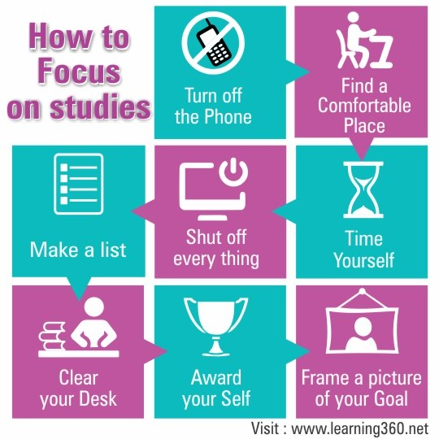
Focus

Slide 9
Repeat it, Repeat it, Repeat it, Repeat it

